Slide 1
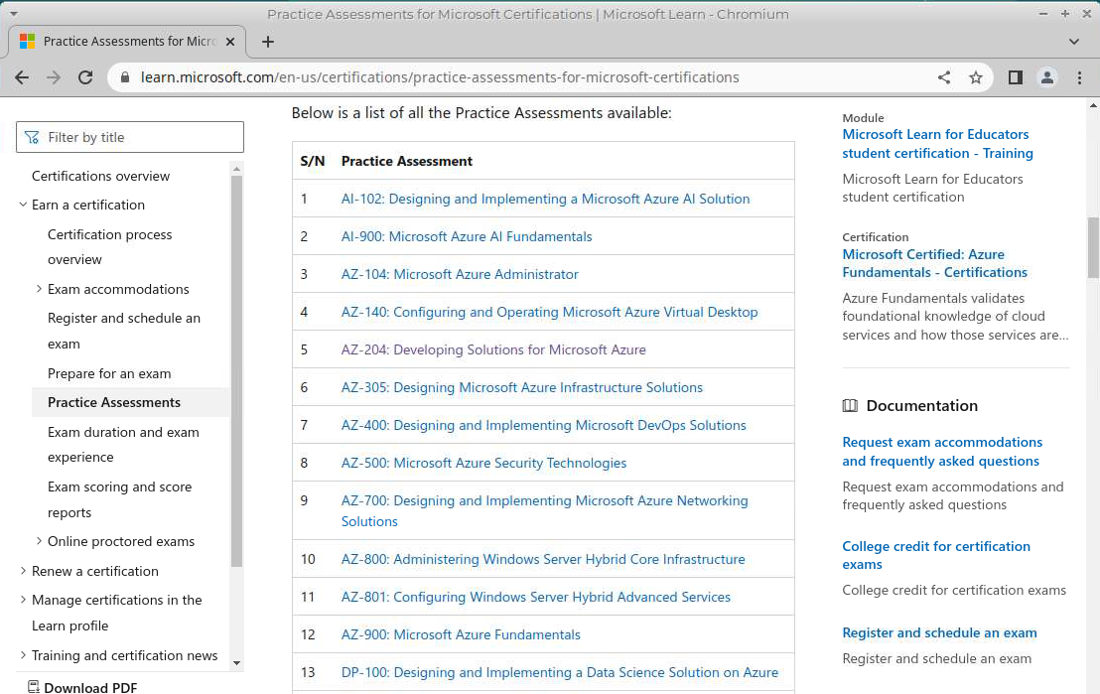
Learning via Practice Assessment

Slide 2
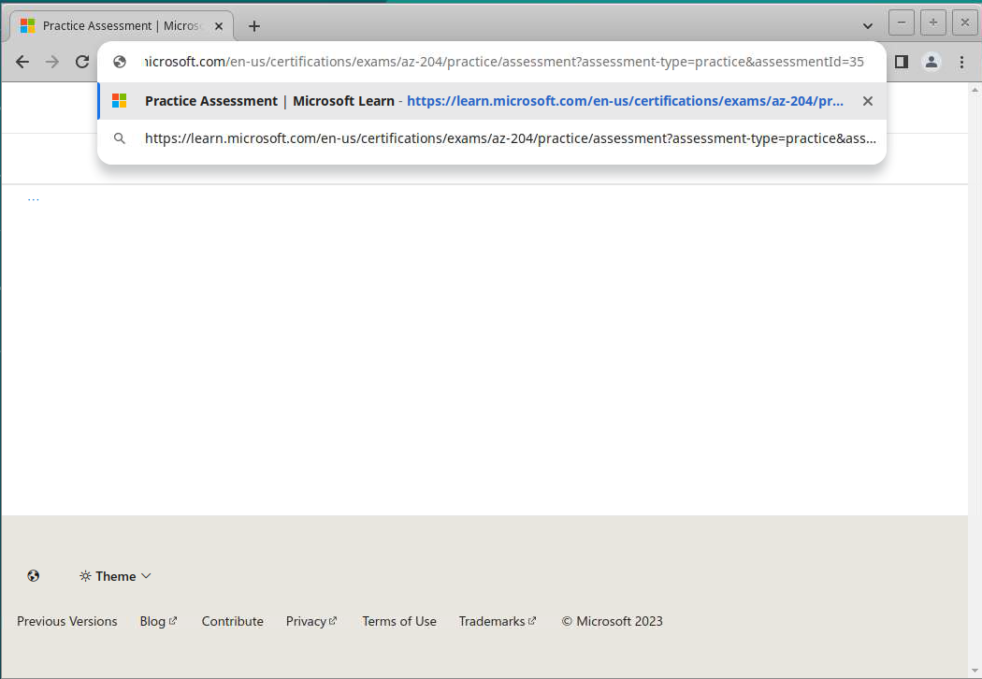
Learning via Practice Assessment

Slide 3
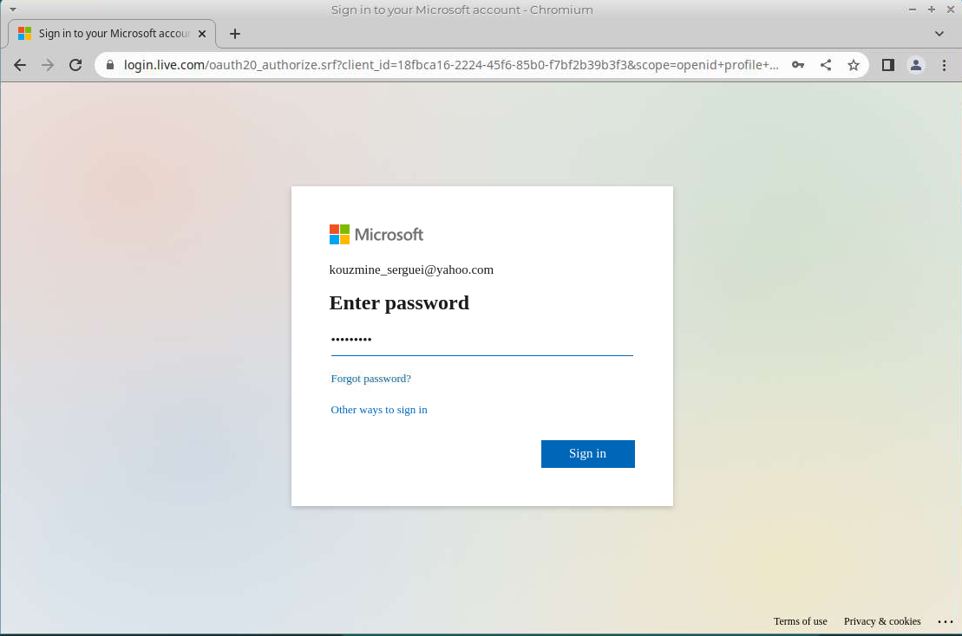
Learning via Practice Assessment

Slide 4
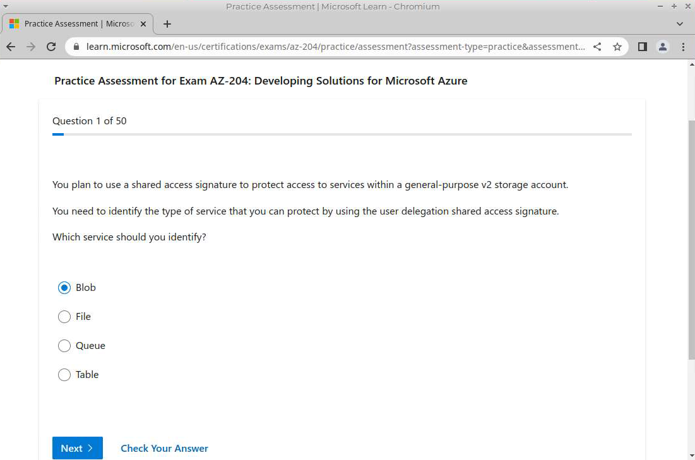
Learning via Practice Assessment

Slide 5
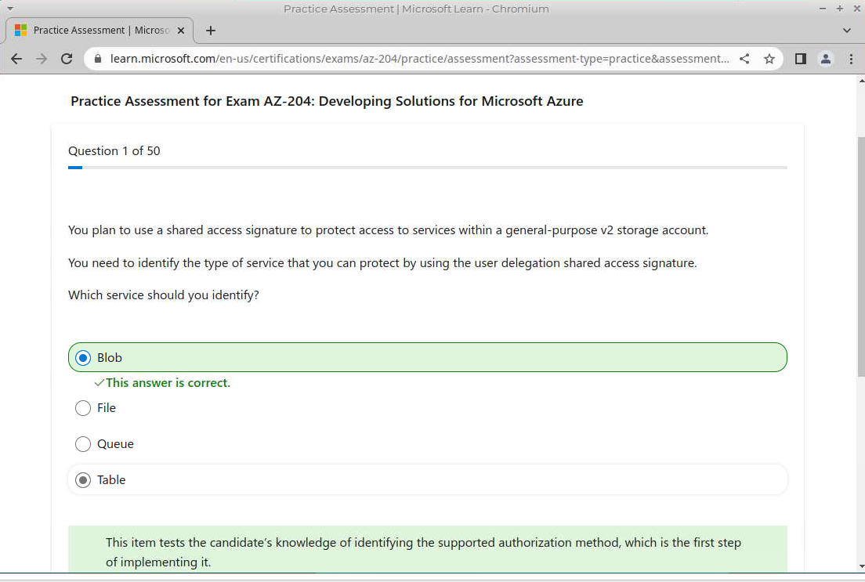
Learning via Practice Assessment

Slide 6
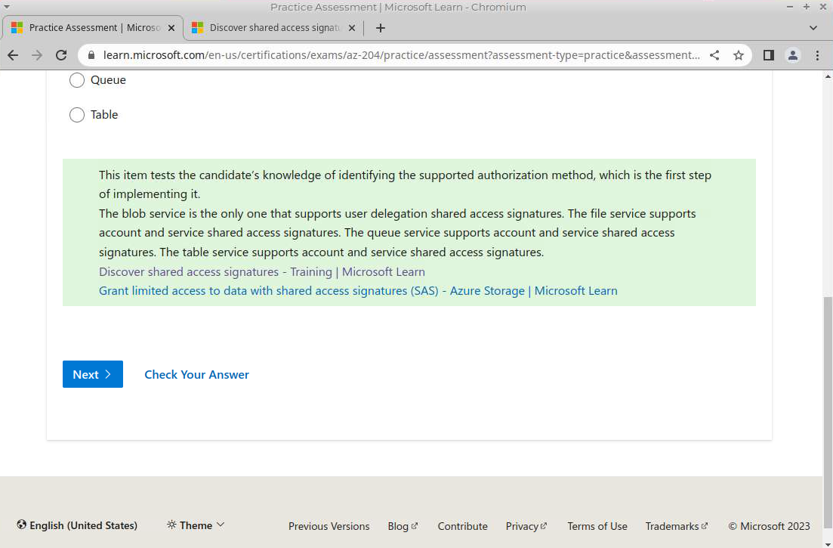
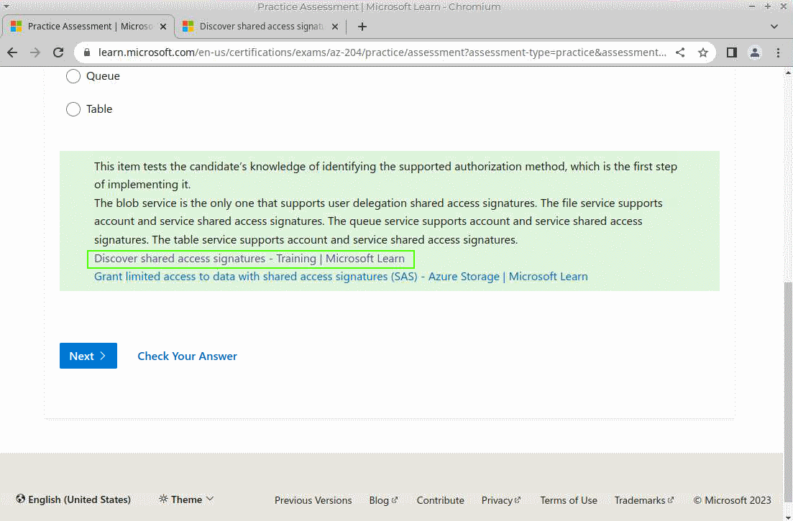
Learning via Practice Assessment

Slide 7
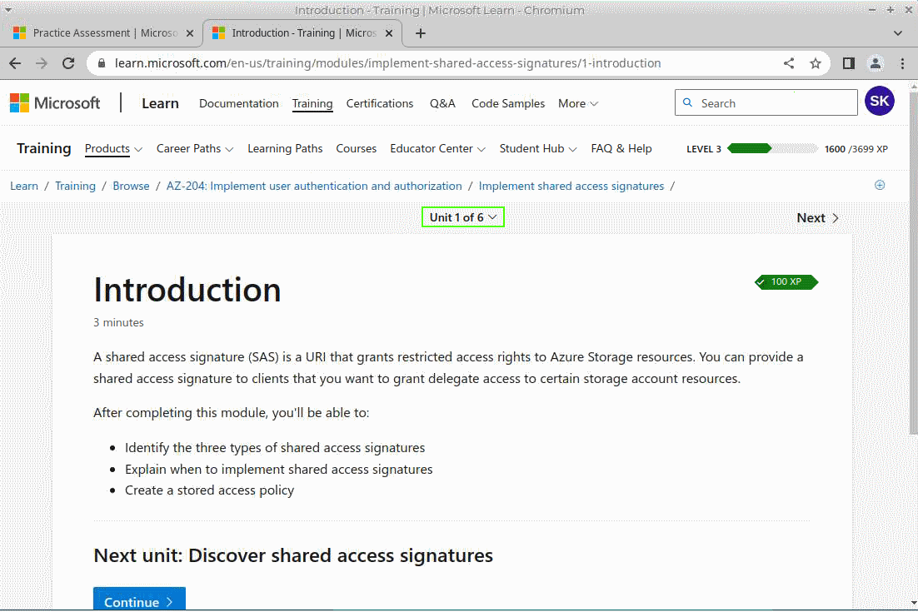
Learning via Practice Assessment

Slide 8
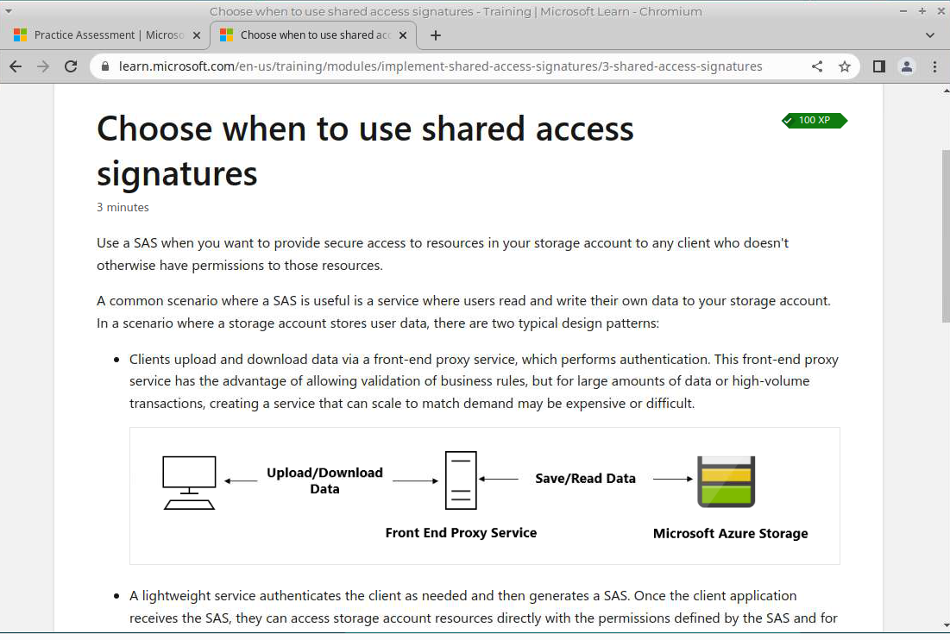
Learning via Practice Assessment

Slide 9
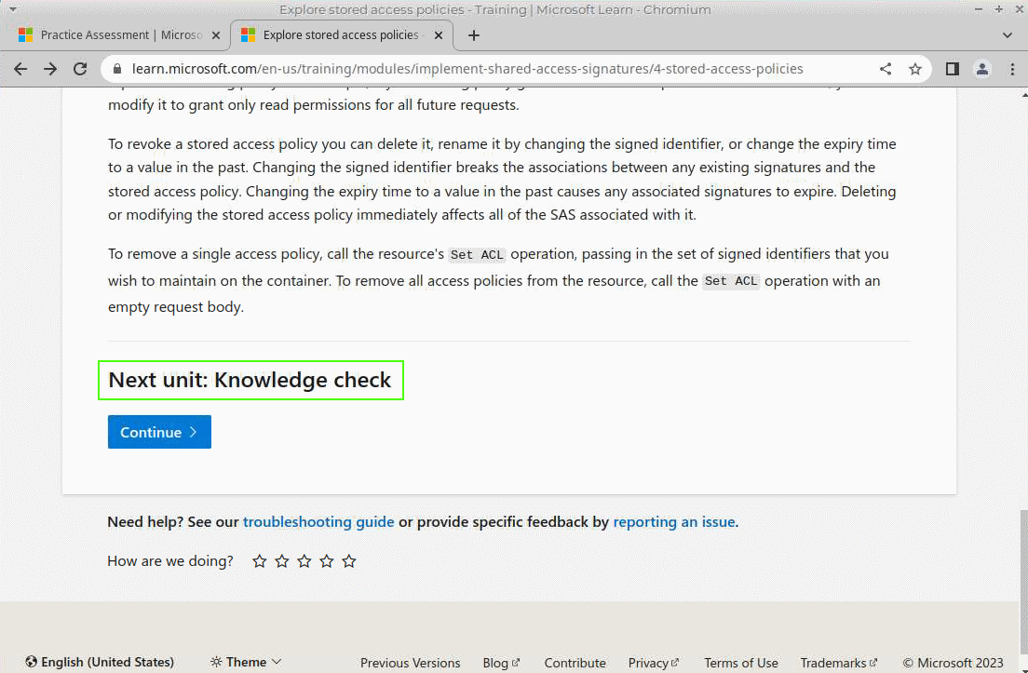
Learning via Practice Assessment

Slide 10
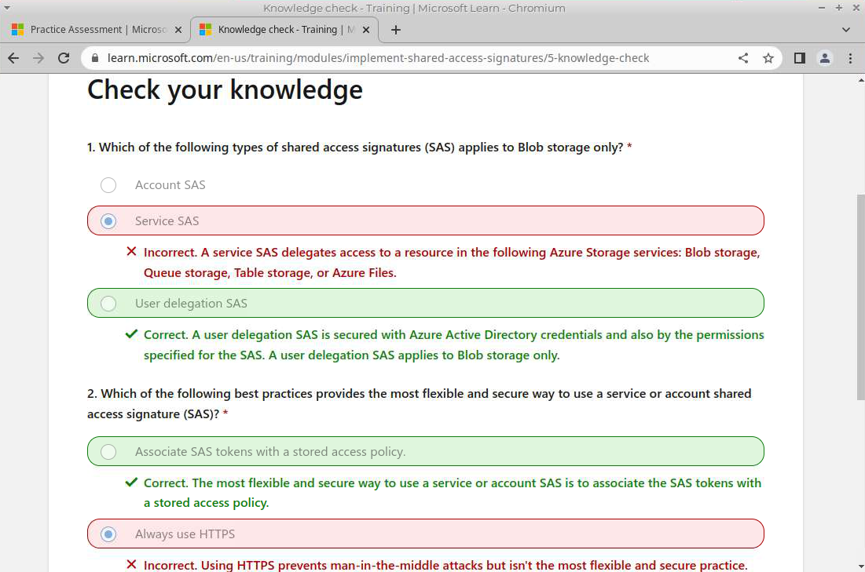
Learning via Practice Assessment

Slide 11
Learning via Practice Assessment
Microsoft practice assessments:
AZ-900: Microsoft Azure Fundamentals
AZ-204: Developing Solutions for Microsoft Azure
AZ-104: Microsoft Azure Administrator
DP-900: Microsoft Azure Data Fundamentals
Azure free account
Exam AZ-900: Microsoft Azure Fundamentals documentation
exam sandbox

